Slide 1
ONLINE INSPECTION OF PACKED CASES
PIP2001 Capstone Project
Review-0
Batch Number: G-125
Student Name | Roll Number
B HARINATH REDDY | 20211CSE0845
D LAKSHMI NIRANJAN REDDY | 20211CSE0838
NOOKALA PAVAN KUMAR | 20211CSE0839
D SAI ESWARA REDDY | 20211CSE0516
K DINESH | 20211CSE0709
Under the Supervision of,
Dr./Mr./Ms./Prof. SUKRUTH GOWDA
Professor / Associate Professor / Assistant Professor
School of Computer Science and Engineering
Presidency University
Name of the Program: B. Tech
Name of the HoD: Dr. Asif Mohammed H.B
Name of the Program Project Coordinator: Dr. Amarnath J.L & Dr. Jayanthi K
Name of the School Project Coordinators: Dr. Sampath A K / Dr. Abdul Khadar A / Mr. Md Ziaur Rahman

Slide 2
Content
Problem Statement
Github Link
Analysis of Problem Statement
Timeline of the Project
References

Slide 3
Problem Statement Number: PSCS69
Organization: ITC Limited
Category (Hardware / Software / Both) : Software
Problem Description: Inspection is a crucial activity to ensure customer satisfaction. Although it doesn’t eliminate the defects in the product, it helps identify the defective products before they are dispatched to the customer. The limitations with the existing inspection process is multi-fold. While Customer expects all the cases to be inspected, due to space and man-power constraints, today, the business is able to achieve only 10% inspection. As the inspection process happens one day after the cases are processed, due to limitations with Expert availability, real-time corrective actions in the factory in case of deviations in product quality gets difficult. Due to human involvement in the visual inspection, there is inherent subjectivity involved in the process
Difficulty Level: Complicated

Slide 4
Github Link
The Github link provided should have public access permission.
Github Link
https://github.com/harinath206/online-inspection-of-packed-cases

Slide 5
Analysis of Problem Statement
Technology Stack Components:
Image Processing & AI Frameworks :
Computer Vision Libraries: OpenCV, PIL (Python Imaging Library).
Deep Learning Frameworks: TensorFlow, PyTorch, Keras for training models.
Pretrained Models: Transfer learning using models such as ResNet, EfficientNet, or MobileNet for feature extraction.

Slide 6
Analysis of Problem Statement (contd...)
Software Requirements:
Data Annotation Tools: LabelImg, CVAT, or VoTT for preparing training datasets.
Backend Frameworks: Flask or Django for deploying the AI model.
Database Management: PostgreSQL or MongoDB for storing inspection data and results.
Deployment Platforms: Docker for containerization, AWS or Google Cloud for scalability.
Edge Devices: NVIDIA Jetson or Raspberry Pi for real-time on-premise analysis.

Slide 7
Analysis of Problem Statement (contd...)
Hardware Requirements :
High-resolution industrial cameras for capturing images of the packed cases.
Adequate lighting setups to ensure consistent image quality.
High-performance GPU for training AI models.

Slide 8
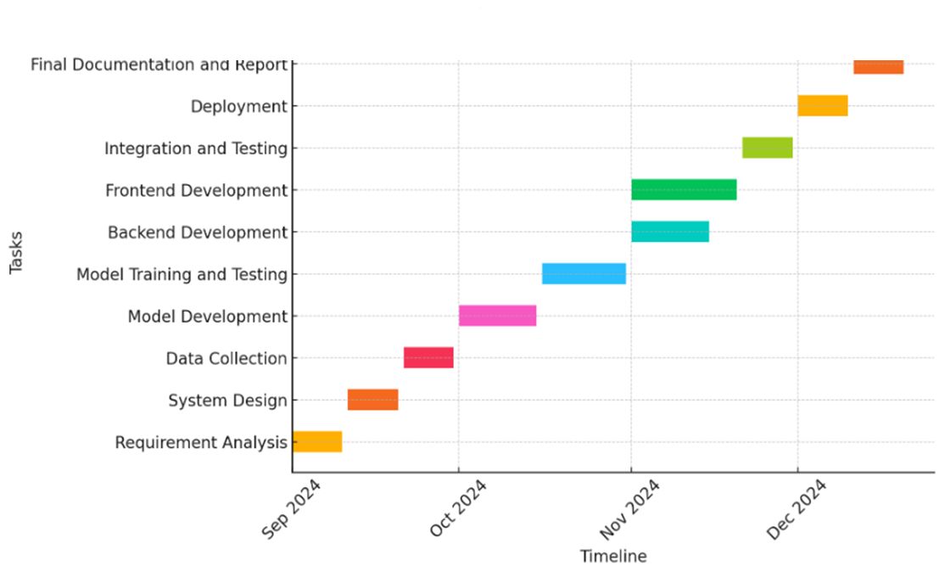
Timeline of the Project (Gantt Chart)

Slide 9
References (IEEE Paper format)
Goodfellow, I., Bengio, Y., & Courville, A. (2016). Deep Learning. MIT Press.
Redmon, J., & Farhadi, A. (2018). YOLOv3: An Incremental Improvement. arXiv preprint arXiv:1804.02767.
Krizhevsky, A., Sutskever, I., & Hinton, G. E. (2012). ImageNet Classification with Deep Convolutional Neural Networks. Advances in Neural Information Processing Systems, 1097–1105.
Zhao, Z., Zheng, P., Xu, S., & Wu, X. (2019). Object Detection with Deep Learning: A Review. IEEE Transactions on Neural Networks and Learning Systems, 30(11), 3212-3232
Rajpurkar, P., Jia, R., Liang, P. (2018). Know What You Don't Know: Unanswerable Questions for SQuAD.

Slide 10


